Slide 1
E-Commerce Product Showcase
"Showcasing the Future of Online Shopping"
Presented By:
Aditya varnekar
Date: 12/12/2024

Slide 2
INTRODUCTION:
Project Overview:
An e-commerce website designed to display products, enable filtering and sorting, and provide a seamless shopping experience.
Purpose:
To develop an interactive and user-friendly multi-page website showcasing products and enabling a smooth online shopping experience.
Technologies Used:
HTML, CSS, JavaScript, Bootstrap.

Slide 3
Key Features
Home Page:
Hero Section: Promotional banner.
Navigation Bar: Links to key sections/pages.
Featured Products: Image, title, price, and a "View Details" button.
Product Listing Page:
Display Products: Filtering by categories and sorting by price/popularity.
Product Details Page:
Product images, description, price, and an "Add to Cart" button.
Cart Page:
Selected products with options to adjust quantity or remove items.
Live Cart Summary: Displays total items and price.

Slide 4
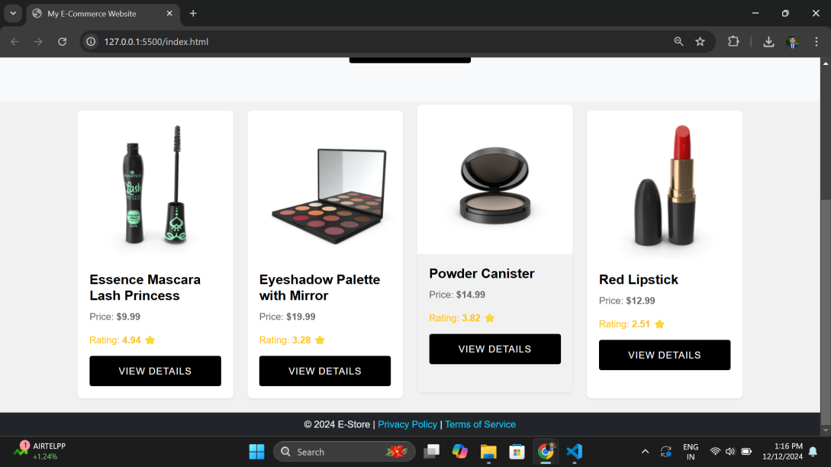
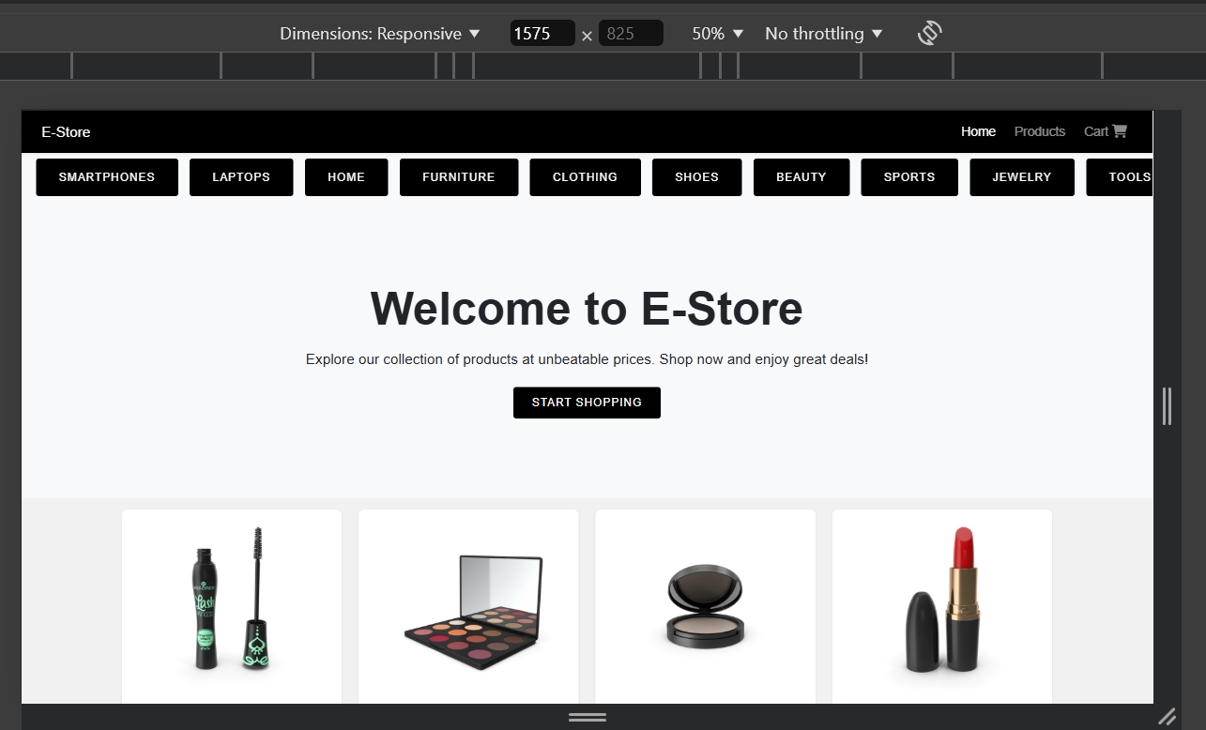
Website Screenshots (Desktop view)

Slide 5
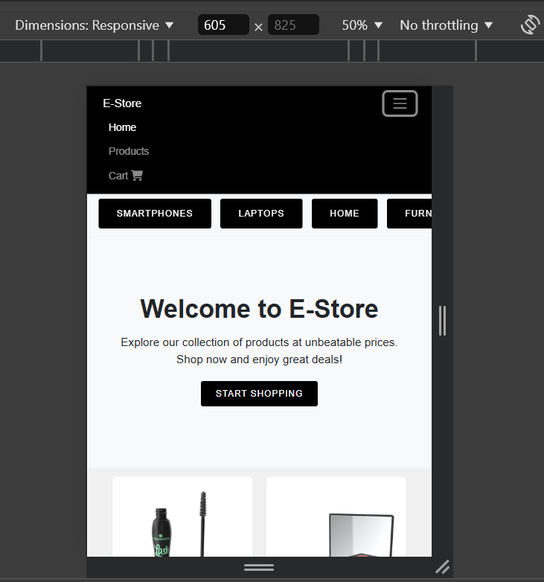
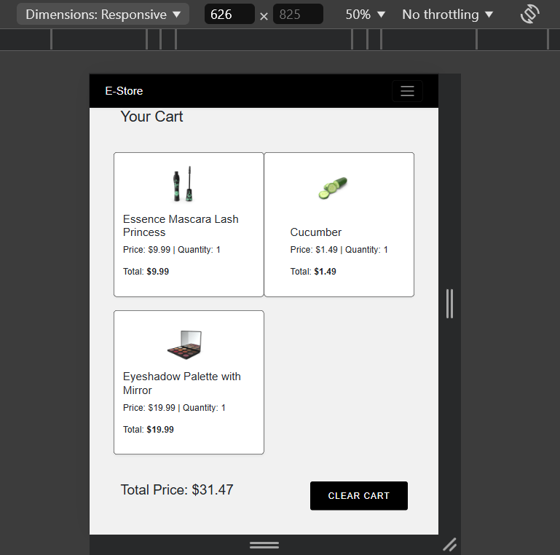
Website Screenshots (Mobile view)

Slide 6
Technical Features
Interactive Features with JavaScript:
Filtering and sorting products.
Add to Cart and Remove from Cart functionality.
Real-time cart updates in the header.
Form Validation: Live validation for checkout.
Custom Styling:
Enhanced visuals with CSS overriding Bootstrap defaults.
Animations: Smooth transitions and hover effects.
Responsive Design:
Fully optimized for desktop, tablet, and mobile devices.
Performance Optimization:
Minified CSS and JavaScript files.
Optimized images for faster load times.

Slide 7
Challenges and Learning
Challenges Faced:
Achieving seamless responsiveness across all screen sizes.
Designing an intuitive user interface with dynamic features.
What I Learned:
Efficient use of Bootstrap for quick yet customized designs.
Enhanced skills in JavaScript interactivity and real-time data handling.

Slide 8
Conclusion
This project highlights my skills in designing a functional, responsive, and visually appealing e-commerce website. It demonstrates proficiency in:
Frontend development.
Problem-solving.
UI/UX design.

